Slide 2
Problem Solving Aspects
Understanding the Problem
You should have clear idea about the problem
Define the input, output, and constraints.

Slide 3
Problem Solving Aspects
Understanding the Problem
You should have clear idea about the problem
Define the input, output, and constraints.
Example:-
# Example Input
num = [1, 2, 3, 4, 5, 6, 7, 8, 9, 10]
# Expected Output
# sum = 2 + 4 + 6 + 8 + 10 = 30

Slide 4
Problem Solving Aspects
Algorithmic Thinking
Plan the logic of your solution using algorithmic thinking.
This involves breaking down the problem into a series of steps or instructions to achieve the desired outcome.

Slide 5
Problem Solving Aspects
Algorithmic Thinking
Plan the logic of your solution using algorithmic thinking.
This involves breaking down the problem into a series of steps or instructions to achieve the desired outcome.
Example:-
def sum(input):
result = 0
for number in input:
if number % 2 == 0:
result += number
return result

Slide 6
Problem Solving Aspects
Use Built-in Functions and Libraries
- Python has a rich standard library with many built-in functions and modules.
Leverage these resources to avoid reinventing the wheel and to write more concise and readable code.

Slide 7
Problem Solving Aspects
Use Built-in Functions and Libraries
- Python has a rich standard library with many built-in functions and modules.
Leverage these resources to avoid reinventing the wheel and to write more concise and readable code.
Example:-
numbers=[1,2,3,4,5,6,7,8,9,10]
result = sum_of_evens(numbers)
print(result)

Slide 8
Problem Solving Aspects
Data Structures
Choose appropriate data structures for your problem.
Python offers various built-in data structures such as lists, dictionaries, sets, and tuples.
Understanding when to use each is crucial for efficient solutions.

Slide 9
Problem Solving Aspects
Code Readability
Write clean, readable, and well-documented code.
Clear and organized code is easier to understand and maintain.

Slide 10
Problem Solving Aspects
Code Readability
Write clean, readable, and well-documented code.
Clear and organized code is easier to understand and maintain.
Example:-
"""Calculate the sum of all even numbers in a given list."""
numbers=[1,2,3,4,5,6,7,8,9,10] ##Declaring the list
result = sum_of_evens(numbers) ##Calling the inbuilt function
print(result)

Slide 11
Problem Solving Aspects
Error Handling
Implement error handling to anticipate and handle unexpected situations gracefully.
Use try-except blocks to catch exceptions and provide meaningful error messages.

Slide 12
Problem Solving Aspects
Testing
Write test cases to verify the correctness of your code.
Example:-

Slide 13
Problem Solving Aspects
Testing
Write test cases to verify the correctness of your code.
Example:-
sum_of_evens([1, 2, 3, 4, 5, 6, 7, 8, 9, 10]) == 30
sum_of_evens([2, 4, 6, 8, 10]) == 30
sum_of_evens([1, 3, 5, 7, 9]) == 0
sum_of_evens([]) == 0
sum_of_evens([1, 'a', 3]) # Raises ValueError

Slide 14
Problem Solving Aspects
Optimization
Optimization is a way to make your program perform any task more efficiently and quickly with fewer lines of code, less memory, or other resources involved, while producing the right results.

Slide 15
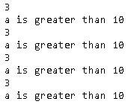
Problem Solving Aspects
Optimization
Optimization is a way to make your program perform any task more efficiently and quickly with fewer lines of code, less memory, or other resources involved, while producing the right results.
Example:-
B=1
C=2
for A in range(1,10):
if A>5:
D=B+C
print(“A is greater than 5”)

Slide 16
Algorithm Vs. Pseudo Code Vs. Flowchart Vs. Program
Algorithm
Set of step-by-step instructions that perform a specific task or operation
Natural language, NOT programming language
Pseudocode
Set of instructions that mimic programming language instructions
Flowchart
Visual program design tool
Semantic symbols describe operations to be performed
Program
Implementation of Algorithm in Programming Language

Slide 17
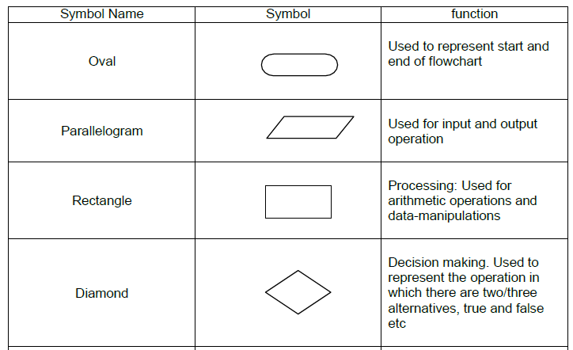
Flowchart Symbols

Slide 18
The Flowchart Rules
sequence control structure
selection control structure
Statement 1
No
Yes
Condition
Statement 2
else-
statement(s)
then-
statement(s)
Statement 3
:

Slide 19
The Flowchart Rules
repetition control structure
yes
Loop
Statement(s)
Condition
no

Slide 20
Exercise
Get marks for 5 subjects from the user and compute the average. If the calculated average is greater than 50, declare that the student has passed the exam; otherwise, mark the student as failed. Create a flowchart to illustrate the process.

Slide 21
Exercise
Draw a flowchart for factorial of a number.

Slide 22
Analysis of Algorithm
Time Complexity
Space Complexity

Slide 23
Analysis of Algorithm
Time Complexity - Linear Search
Best Case: O(1)
Average Case: O(n/2)
Worst Case: O(n)

Slide 24
Analysis of Algorithm
Time Complexity - Linear Search
Best Case: O(1) - If the element being searched is at the beginning of the list.
Average Case: O(n/2) - In the average case, you might find the element in the middle of the list, so, on average, you need to search half of the list.
Worst Case: O(n) - If the element being searched is at the end of the list or not present at all.

Slide 25
Analysis of Algorithm
def constant_example(arr):
return arr[0]
Time Complexity – ?
Space Complexity – ?

Slide 26
Analysis of Algorithm
def constant_example(arr):
return arr[0]
Time Complexity – O(1)
Space Complexity – O(1)

Slide 27
Analysis of Algorithm
def linear_example(arr):
for element in arr:
print(element)
Time Complexity – ?
Space Complexity – ?

Slide 28
Analysis of Algorithm
def linear_example(arr):
for element in arr:
print(element)
Time Complexity – O(n)
Space Complexity – O(1)

Slide 29
Time Complexity and Space Complexity
Example:-
def sum_elements(arr):
total = 0
for num in arr:
total += num
return total
Time Complexity – ?
Space Complexity – ?

Slide 30
Time Complexity and Space Complexity
Example:-
def sum_elements(arr):
total = 0
for num in arr:
total += num
return total
Time Complexity – O(n)
Space Complexity – O(1)

Slide 31
Time Complexity and Space Complexity
Example:-
def generate_number_pairs(n):
number_pairs = {}
for i in range(1, n+1):
number_pairs[i] = i * 2
return number_pairs
Time Complexity – ?
Space Complexity – ?

Slide 32
Time Complexity and Space Complexity
Example:-
def generate_number_pairs(n):
number_pairs = {}
for i in range(1, n+1):
number_pairs[i] = i * 2
return number_pairs
Time Complexity – O(n)
Space Complexity – O(n)

Slide 33
Time Complexity and Space Complexity
Example:-
def logarithmic_example(n):
count = 0
while n > 1:
n //= 2
count += 1
return count
Time Complexity – ?
Space Complexity – ?

Slide 34
Time Complexity and Space Complexity
Example:-
def logarithmic_example(n):
count = 0
while n > 1:
n //= 2
count += 1
return count
Time Complexity – O(log n)
Space Complexity – O(1)

Slide 35
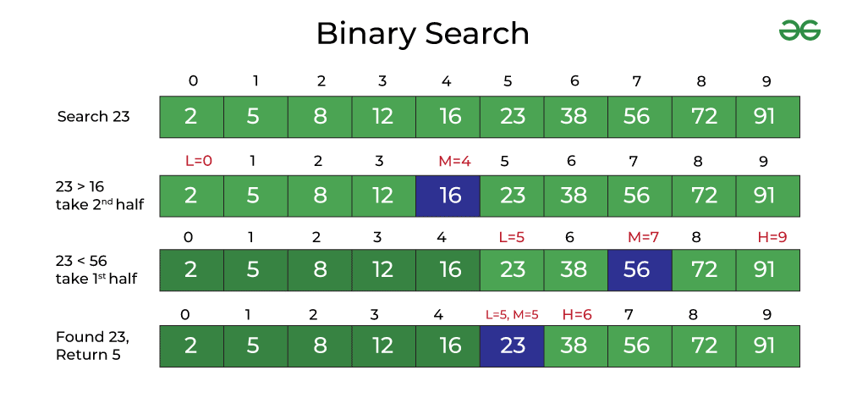

Slide 36
Time Complexity and Space Complexity
Example:-
def binary_search(arr, target):
low, high = 0, len(arr) - 1
while low <= high:
mid = (low + high) // 2
if arr[mid] == target:
return mid # Target found
elif arr[mid] < target:
low = mid + 1
else:
high = mid - 1
return -1 # Target not found
Time Complexity – ?
Space Complexity – ?

Slide 37
Time Complexity and Space Complexity
Example:-
def binary_search(arr, target):
low, high = 0, len(arr) - 1
while low <= high:
mid = (low + high) // 2
if arr[mid] == target:
return mid # Target found
elif arr[mid] < target:
low = mid + 1
else:
high = mid - 1
return -1 # Target not found
Time Complexity – O(log n)
Space Complexity – O(1)

Slide 38
Time Complexity and Space Complexity
def quadratic_example(arr):
n = len(arr)
for i in range(n):
for j in range(n):
# Some operation (e.g., comparison)
result = arr[i] > arr[j]
Time Complexity – ?
Space Complexity – ?

Slide 39
Time Complexity and Space Complexity
def quadratic_example(arr):
n = len(arr)
for i in range(n):
for j in range(n):
# Some operation (e.g., comparison)
result = arr[i] > arr[j]
Time Complexity – O(n^2)
Space Complexity – O(n)

Slide 40
Problem Solving (Algorithm) Techniques
Brute-force or exhaustive search
Divide and Conquer
Greedy Algorithms
Dynamic Programming
Backtracking

Slide 41
Brute-Force
Simple, Straight Forward but time consuming.
Example: Padlock with 3 Digits.

Slide 42
Divide and Conquer
Problem divided into sub problems, sub problems are solved independently and merge the solutions of sub problem for final solution of the problem.
Example: Summing the list of numbers.

Slide 43
Greedy Algorithm
Decisions are taken based on Local Optimal Solution at every stage.
Finding Shortest path.

Slide 44
Dynamic Programming
Mathematical Optimization Problem
Breaks the problem into sub problems, solve the sub problems over time as sequence to reach the final solution.
Uses Recursion
Example: Arranging the cards for rummy game.

Slide 45
Back Tracking
Incremental Approach
Uses the previous stage solution to next stage solution
Examples: Crossword

